Slide 1
Transforming Your SharePoint Full Trust Code to the SP App Model
Vesa Juvonen
Senior Program Manager, Office 365
Microsoft

Slide 2

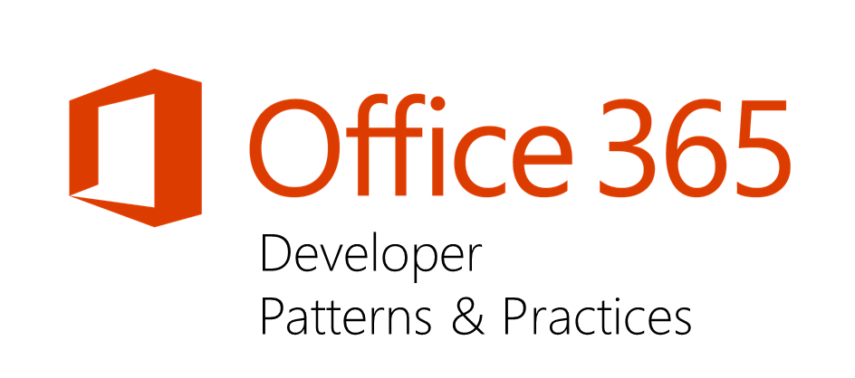
Vesa Juvonen
Senior Program Manager, Microsoft
twitter.com/@vesajuvonen
vesa.juvonen@microsoft.com
App model questions to http://aka.ms/OfficeDevPnPYammer please
Office 365 Dev Patterns and Practices program lead, SharePoint MCM/MCSM, JDP program technical lead, hands on in transition projects for customers and in engineering

Slide 3
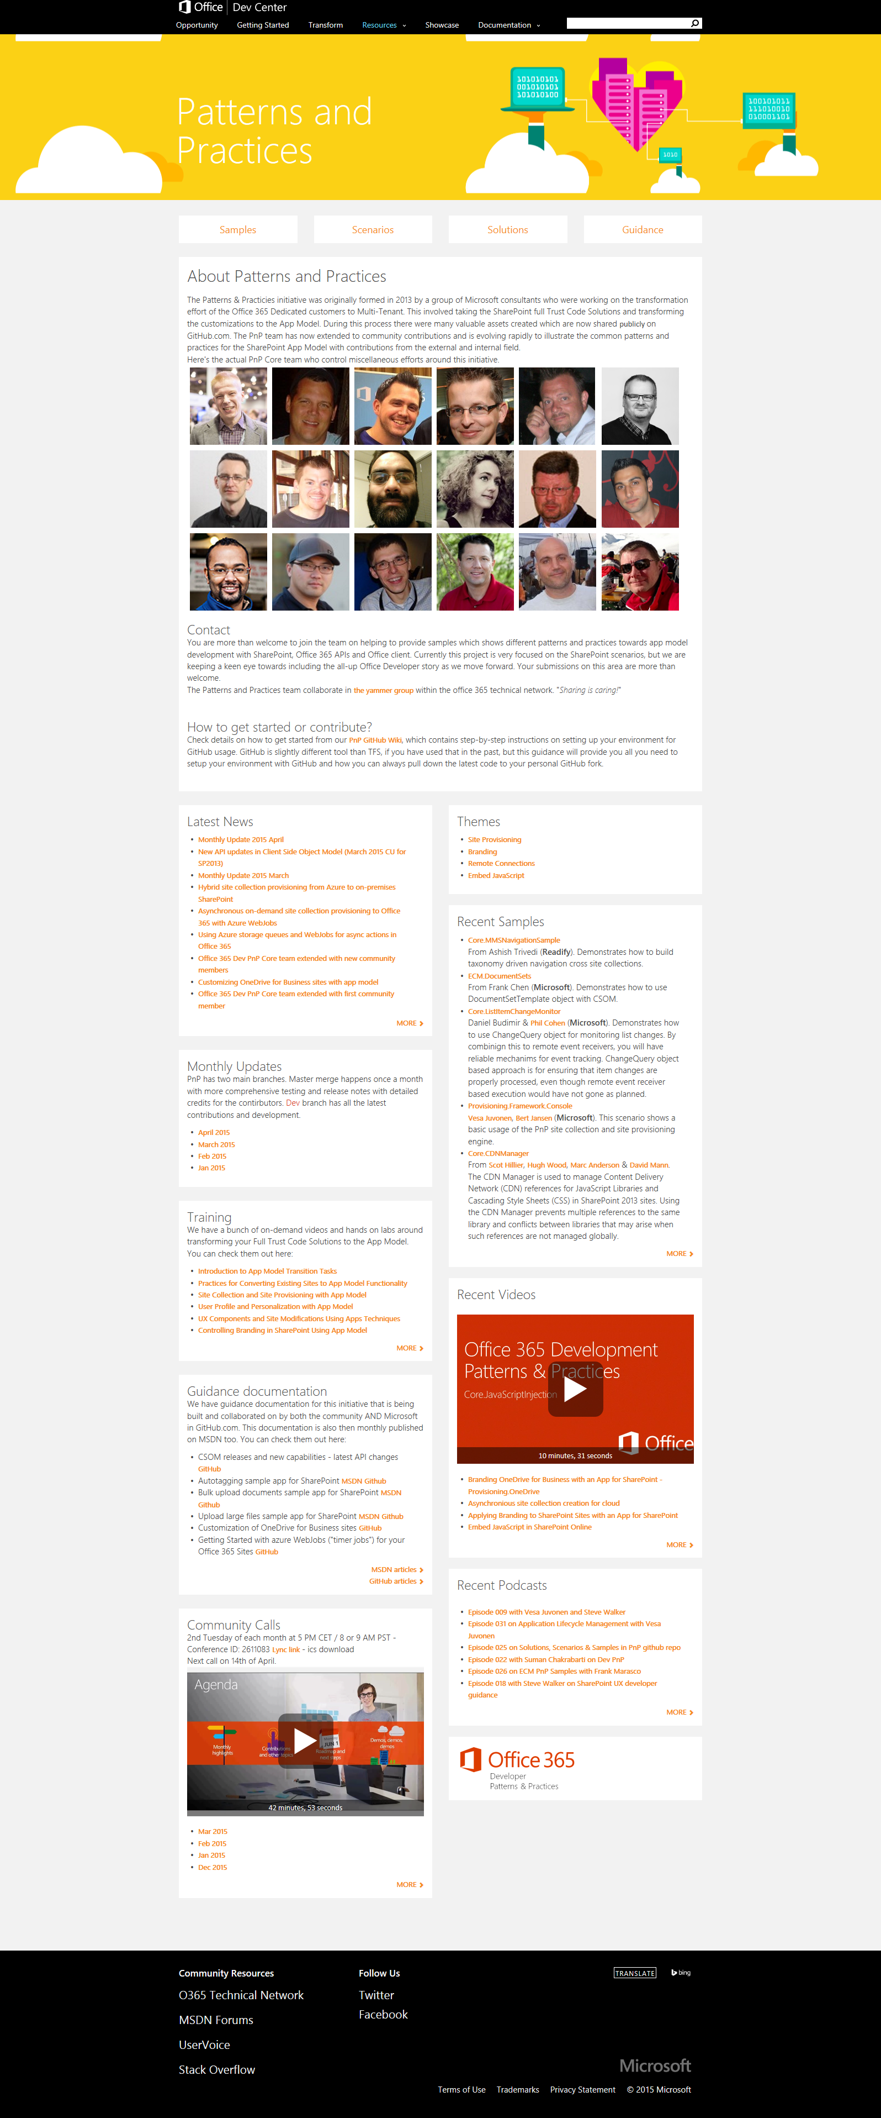
“Sharing is caring”
aka.ms/OfficeDevPnP
aka.ms/OfficeDevPnPYammer
aka.ms/OfficeDevPnPMSDN
aka.ms/OfficeDevPnPVideos
aka.ms/OfficeDevPnPTraining

Slide 4

Agenda
What does the transformation actually means?
Transforming typical functionalities
Guidance for the transformation
Demos, demos, demos
Notes:
Vesa

Slide 5
“What does app model transformation means?”
Rewrite
Rewrite your code to app model. There’s actually no migration or transformation as such, but you can reuse concepts and patterns…
Notes:
Vesa

Slide 6
“What does this mean in practice?”
Implement similar functional capabilities as with farm solutions, using alternative technical solution
Notes:
Vesa

Slide 7
“Don’t we have a tool to help to migrate code?”
Great assessment tools exists, but this is not really about one-to-one transition…

Slide 8
“So I need to throw everything away and start from scratch?
No.
We are talking about technical implementation change, which does not mean that business requirements, functional requirements and process planning has to be thrown away

Slide 9
What is the most resource intensive phase in projects?
Actual coding implementation or getting business and functional requirements truly covered in the solution?

Slide 10





Transformation process Model we use with customers for the transformation
Readiness
Assessment
Planning
Implementation
Deployment
Readiness with app model topics
Hosting decisions
Network impact analyses
Development model readiness
Analyze existing solution usage
Analyze existing code and functionality
Concentrate on business and functional requirements, not on technology
App model solution planning and design
What patterns and models are used for different solutions
What solutions can be converted to out of the box capabilities
Detailed technical planning
Actual app model solution implementation
Typical development process, including testing
App solution deployment
Existing content retrofitting
Farm solution retraction
Note. Reusable process guidance and documents will be released later this spring for re-use by the field…

Slide 11
“But app model is pattern for cloud, not for my on premise…”
Really?

Slide 12
What if…
We would use same development model in cloud and in on-premises?
Notes:
Is that Tobias?

Slide 13
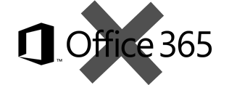
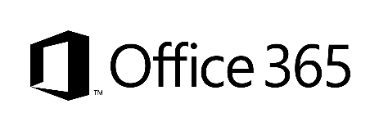
What does “app model” mean in our terminology
SharePoint App Model – all operations which are executed outside of the server
Classic - Full trust solutions
ISV solutions
Client Side Solutions
Remote provisioning for elements
Store apps
App catalog based solution
Custom service applications
Custom WCF services
Platform level customizations to on-premises
Server side controls as JavaScript on page layouts and master pages
Embracing un-ghosted model
SP App dimension with provider hosted apps to provide new capabilities
Packaged reusable solutions built for specific functionality
SharePoint customizations, not customer specific customizations
Customer specific customizations
Not only for market place or store, but also as platform for customer specific customizations

Slide 14
JS embedding
Modification of host sites without installing app parts

Slide 15
“But I do want to do customizations using full trust code way!”
Feel free to do that in future as well. It comes down on the business and functional requirements, together with deployment roadmap.
Notes:
Steve
Time: 15:00

Slide 16
“Will Farm Solutions be supported with SharePoint Server 2016”
Yes.
We will make though investments mainly on the app model side also for on-premises to better align the development story: Write once and use it cross cloud and on-premises
Notes:
Vesa

Slide 17
“Will you ever support farm solutions in Office 365?”
No.
Farm solutions are deployed cross SharePoint farm and they’d impact multiple customers…
Notes:
Vesa:
Time: 42:00

Slide 18
“I saw a blog post on the Internet saying that the app model is dead”
No it’s not
It’s more live than ever. We are committed to this model and the majority of our development investments are made on the app model for cloud AND on-premises
Notes:
Vesa

Slide 19
“Will you introduce a replacement for the app model in the near future?”
No.
We are 100% committed on loosely coupled model with remote APIs. We will certainly evolve the capabilities, but model is here to stay
Notes:
Steve
Time: 44
NOTE: You may have seen our investments in Common Consent and O365 APIs, this should help you understand that we are investing in evolving this model going forward !!!

Slide 20
“I can’t do XYZ with app model?”
There are numerous things which might not be available as such with app model, but functional requirements can be often achieved using alternative methods
Notes:
Vesa
Time: 45

Slide 21
Remote timer job
Scheduled execution which accesses the needed resources from the SharePoint service and performs the required automation.
Can use either specific account for connection or oAuth based app-only token approach
SharePoint Service
Provider Hosted Apps
1
Remote timer job
2

Slide 22
Remote timer jobs
Timer job based implementations using Azure WebJobs

Slide 23
“What about branding?”
All typical branding models are fully supported with the app model techniques for Office 365 and on-premises
More details on “Safe Branding” session on Tuesday at 3:45 PM.

Slide 24
“What about site provisioning?”
We recommend gradually moving away from the xml based models and replace them with remote API operations
“Site provisioning techniques with app model” session on Wednesday at 11:45. Jaw dropping demo.

Slide 25
“Wait? No feature framework?”
We are indeed gradually moving away from feature framework to alternative patterns…
Notes:
Steve
Time: 15:00

Slide 26
You can actually do much more with provider hosted model than with typical farm solutions…
Especially Azure based solutions have pretty much infinite opportunities. Approaches are slightly different, but the engine is super powerful
Notes:
Vesa
Time: 45

Slide 27
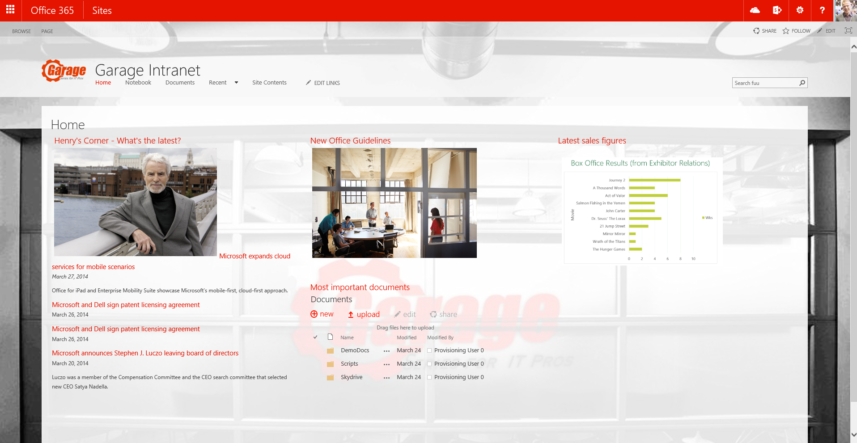
Asynchronous pattern with WebJobs
Provider Hosted Apps
2
SharePoint
<<Add message>>
<<Run app functionality>>
Storage Queue
1
3
<< Perform needed actions>>
WebJob
<<instantiate>>
4

Slide 28
One Drive for business modifications
Looking into more complex pattern to take care of OneDrive for Business modifications using Azure Storage Queues and WebJobs

Slide 29
Summary
What does the transformation actually means?
Transforming typical functionalities
Guidance for the transformation
Demos, demos, demos
Notes:
Vesa

Slide 30
“Sharing is caring”
aka.ms/OfficeDevPnP
aka.ms/OfficeDevPnPYammer
aka.ms/OfficeDevPnPMSDN
aka.ms/OfficeDevPnPVideos
aka.ms/OfficeDevPnPTraining

Slide 31
Thank you for attending!
Vesa Juvonen,
Microsoft

